Slide 1



FHIR North FHIR Intro
Lloyd McKenzie
April 29, 2015

Slide 2

Who am I?
Name: Lloyd McKenzie
Company: Gevity
Background:
One of FHIR’s 3 principle editors
Co-chair FHIR Management Group
Co-chair HL7 Modeling & Methodology
Chair HL7 Canada Architecture & Infrastructure
Heavily involved in HL7 and healthcare exchange for last 15 years (v2, v3, CDA, etc.)

Slide 3
Connectathon management
Wiki page here:
wiki.hl7.org/?title=FHIR_North
Add your information into the linked Google document
Send a Skype invite to lmckenzi and we’ll tie you into the group skype chat

Slide 4
Objectives
Quick overview of what’s different about FHIR
Understand how to find information in the specs
Understand key concepts around resources, bundles and the RESTful interface
Get you up and running
Answer questions

Slide 5

This presentation
Can be downloaded here:
http://gforge.hl7.org/svn/fhir/trunk/presentations/2015-04 FHIR North/FHIR North - intro.pptx
Use “anonymous” and email address to logon
Is licensed for use under the Creative Commons, specifically:
Creative Commons Attribution 3.0 Unported License
(Do with it as you wish, so long as you give credit)

Slide 6
Show of hands
Who hasn’t read anything from the FHIR spec?
Who hasn’t written any FHIR code (even for this connectathon)
Who is hoping to have a production FHIR interface in the next year?
Who is here just to observe?

Slide 7
What is FHIR?

Slide 8
The acronym
F – Fast (to design & to implement)
Relative – No technology can make integration as fast as we’d like
H – Health
That’s why we’re here
I – Interoperable
Ditto
R – Resources
Building blocks – more on these to follow
Notes:
9:25

Slide 9
FHIR Manifesto
Focus on implementers
Keep common scenarios simple
Leverage existing technologies
Provide human readability
Make content freely available
Support multiple paradigms & architectures
Demonstrate best practice governance
Notes:
We don’t actually have a formal manifesto, but these are the principles we adhere to.
More stuff on implementers, common scenarios & paradigms

Slide 10
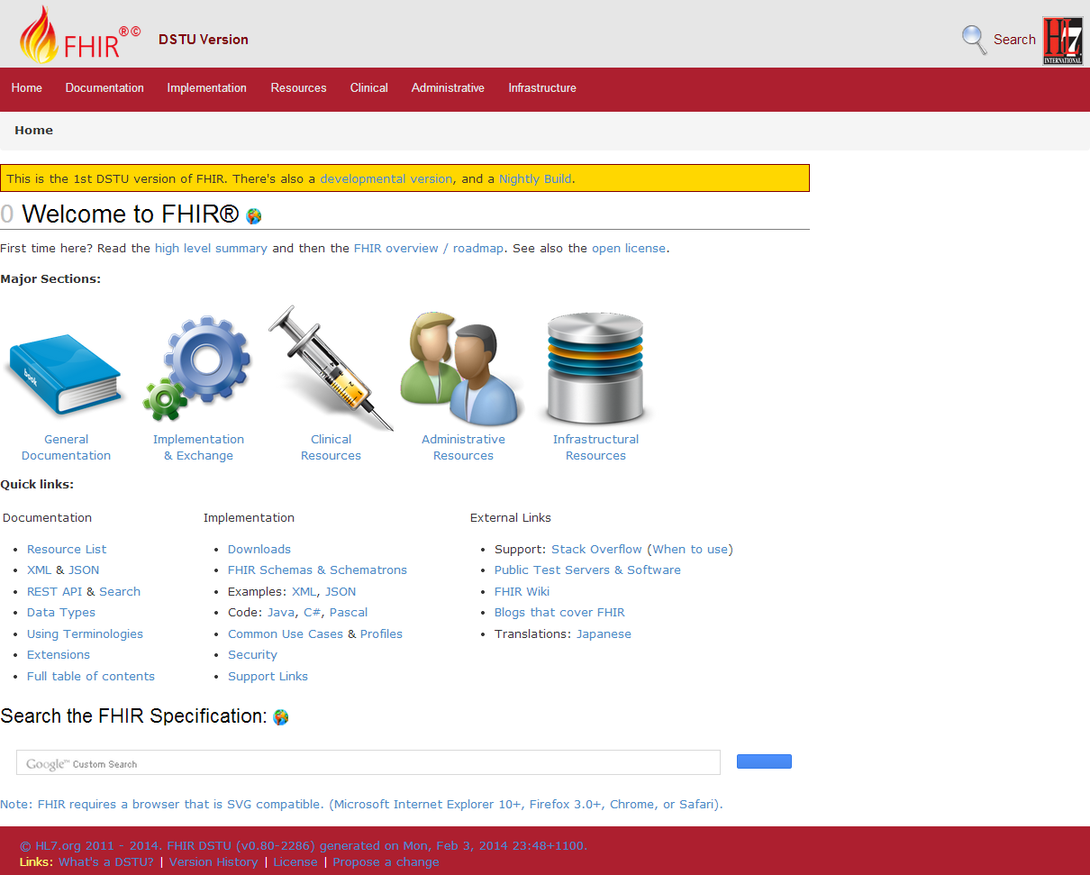
Browsing the site
Notes:
Downloads
Wiki
Table of Contents
Key stuff in Documentation
Overview & Roadmap
Developer’s Intro
Base Resource
DomainResource
Formats
XML, JSON
Data Types
Using Code Systems
Key stuff in Implementation
REST
Search

Slide 11
Sections to review
Downloads, Wiki, Table of Contents
Documentation
Overview & Roadmap, Developer’s Intro, Base Resource, DomainResource, Formats, XML, JSON, Data Types, Using Code Systems
Implementation
REST
Search

Slide 12


Resources
“Resources” are:
Small logically discrete units of exchange
Defined behavior and meaning
Known identity / location
Smallest unit of transaction
“of interest” to healthcare
V2: Sort of like Segments
V3: Sort of like CMETs
Notes:
Unit of storage / transaction: you cannot send “partial” updates

Slide 13
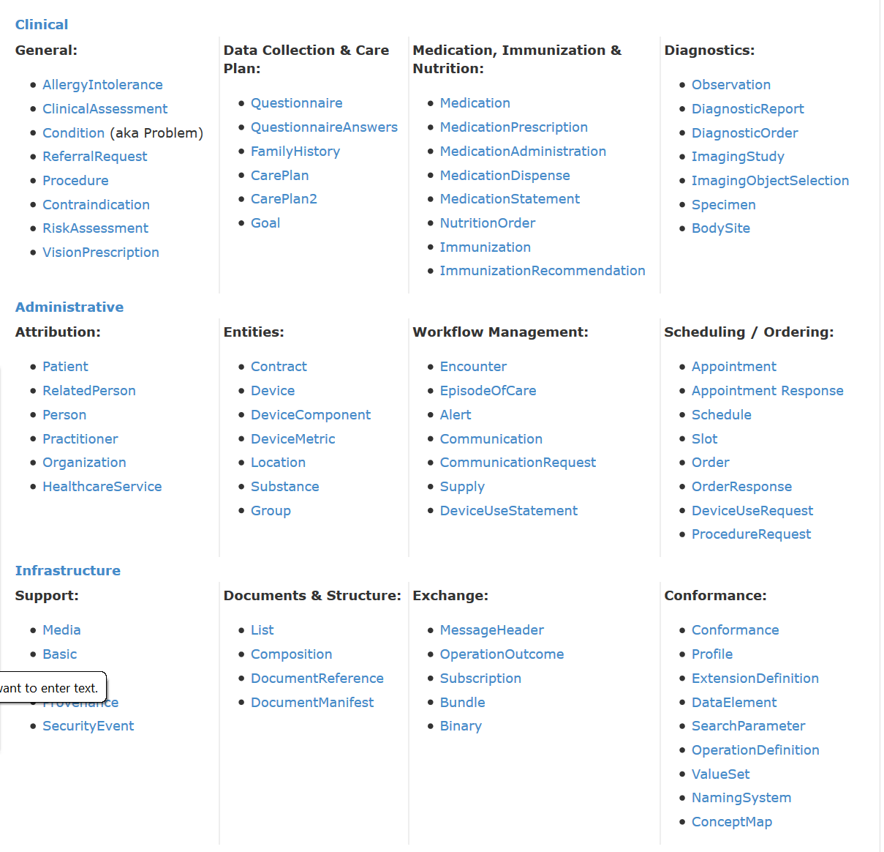
DSTU Resource List

Slide 14
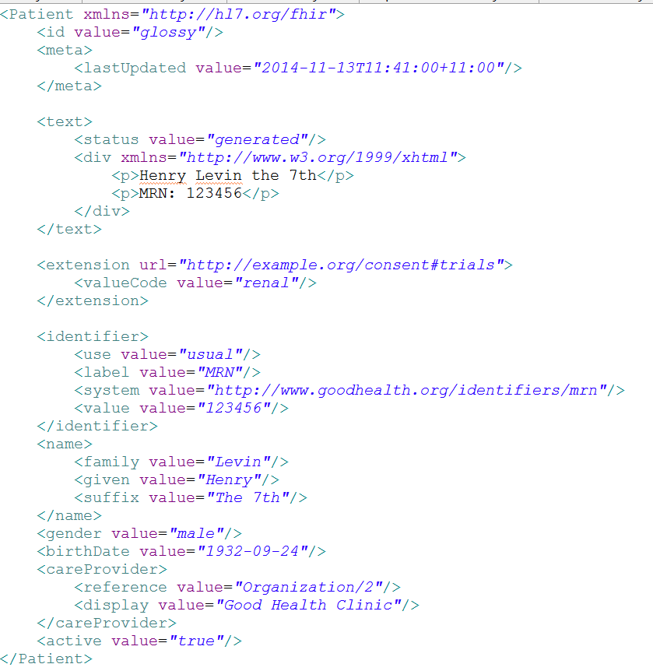
Identity & Metadata
Human Readable Summary
Extension with reference to its definition
Standard Data Content:
MRN
Name
Gender
Date of Birth
Provider
Notes:
System for gender is wrong . . .

Slide 15
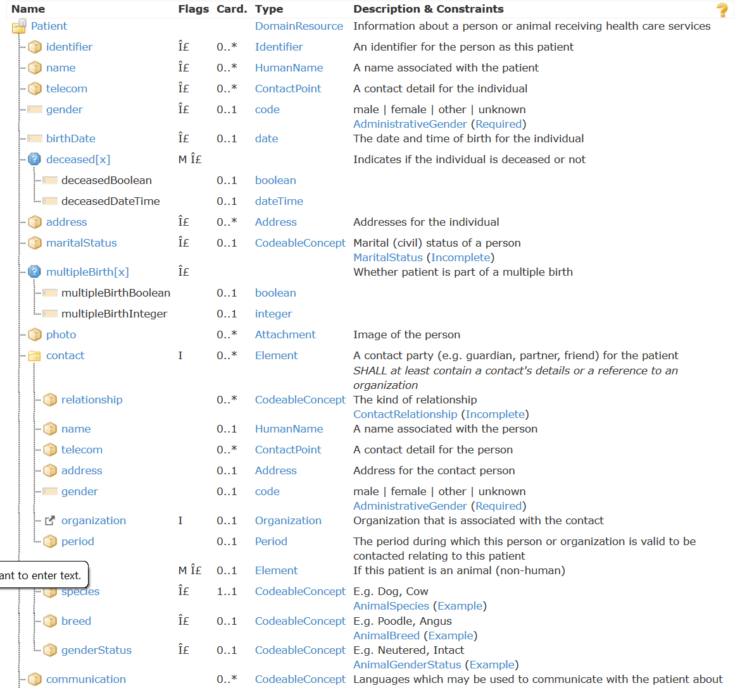
Resource Definitions

Slide 16
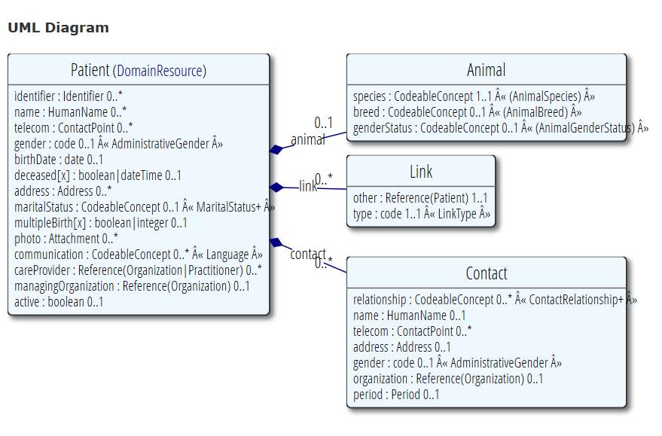
Resource Definitions

Slide 17
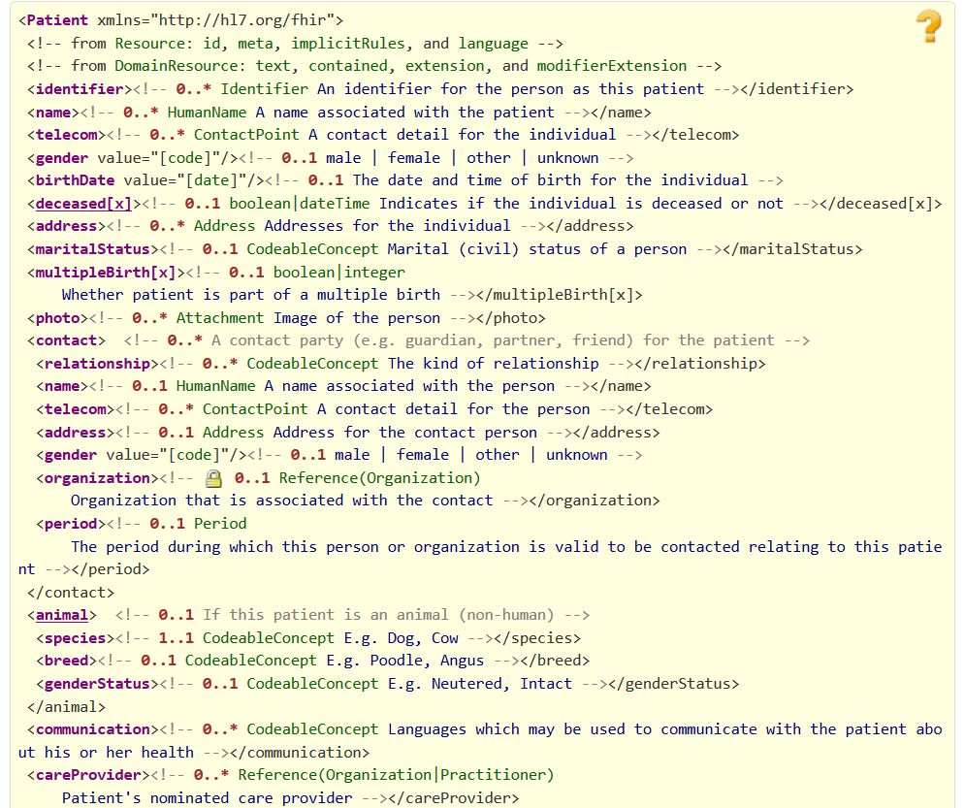
Resource Definitions

Slide 18
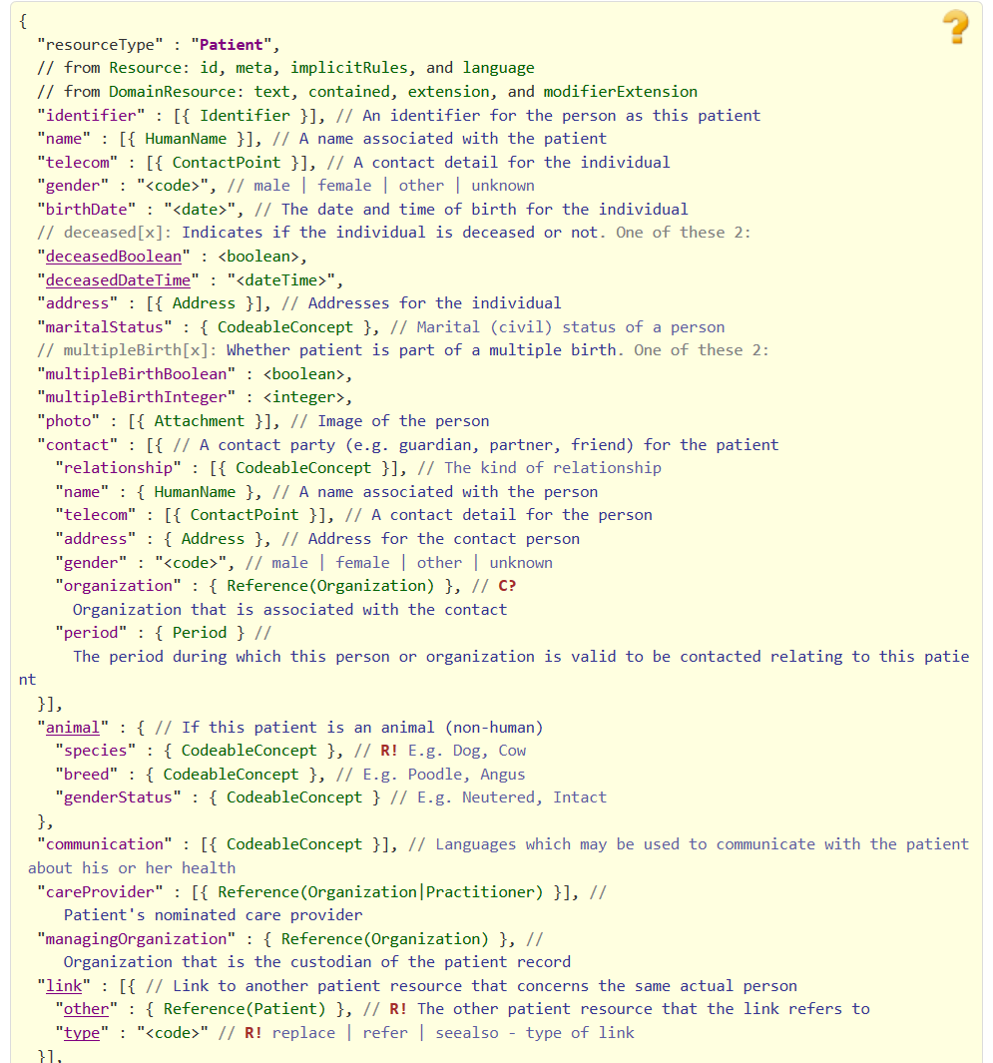
Resource Definitions

Slide 19
Just a quick GET
GET /fhir/Patient/1 HTTP/1.1
HTTP/1.1 200 OK
Content-Type: application/xml+fhir;charset=utf-8
Content-Length: 787
Content-Location:
http://fhir.furore.com/fhir/Patient/1/_history/1
Last-Modified: Tue, 29 May 2012 23:45:32 GMT
HTTP Verb + path
UTF-8 encoded
<?xml version="1.0" encoding="UTF-8"?>
<Patient xmlns="http://hl7.org/fhir"><identifier><label>SSN</label><identifier><system>
http://hl7.org/fhir/sid/usssn</system><id>444222222</id></identifier></identifier><name><use>official</use><family>Everywoman</family><given>Eve</given></name><telecom><system>phone</system><value>555-555 2003</value><use>work</use></telecom><gender><system>http://hl7.org/fhir/sid/v2-0001</system>
<code>F</code></gender><birthDate>1973-05-31</birthDate><address><use>home</use><line>2222 Home Street</line></address><text><status>generated</status><div xmlns="http://www.w3.org/1999/xhtml">Everywoman, Eve. SSN:444222222</div></text></Patient>
See the BOM?
Notes:
You can retrieve any person using a GET on the person’s id, which is just an url on the server: /fhir/person/@<id>
We have our own MIME-type: “text/xml+fhir”
Note that FHIR always uses UTF-8. Since this is not the default for HTTP, the server explicitly mentions this
But should mean the xml encoding mentions “utf-8” and that the payload is really encoded in utf-8
There can be a Byte Order Mark, but hopefully your framework handles all that ;-)
The response returns a Content-Location header with a version-specific location….see next slide

Slide 20
A Resource’s identity
In fact: a URL
https://server.org/fhir/Patient/1
resource type
endpoint
identifier
Note: This URL resolves to the current version of a resource
Notes:
This is not only the URL you use to retrieve the resource, it’s also its id.
All URLs in FHIR are case-sensitive (and so is the id)
It is *metadata*, you won’t find this in the Resource’s definition

Slide 21
For a specific version…
We have the version-specific URL
https://server.org/fhir/ (continued)
Patient/1/_history/4
base path
resource type
identifier
version id
Notes:
Both the Resource id URL and the version-specific URL are used on many places of the REST spec and resource content (References!). They are always used consistently in this form.

Slide 22
REST “representations”
GET /fhir/Patient/1?_format=json HTTP/1.1
HTTP/1.1 200 OK
Content-Type: application/json+fhir;charset=utf-8
Content-Length: 787
GET /fhir/Patient/1 HTTP/1.1
Accept: application/json+fhir
HTTP/1.1 200 OK
Content-Type: application/json+fhir;charset=utf-8
Content-Length: 787
Notes:
You can retrieve any person using a GET on the person’s id, which is just an url on the server: /fhir/person/@<id>
We have our own MIME-type: “text/xml+fhir”
Note that FHIR always uses UTF-8. Since this is not the default for HTTP, the server explicitly mentions this
But should mean the xml encoding mentions “utf-8” and that the payload is really encoded in utf-8
There can be a Byte Order Mark, but hopefully your framework handles all that ;-)
The response returns a Content-Location header with a version-specific location….see next slide

Slide 23
Mapping to verbs
create 2.1.10
The create interaction creates a new resource in a server assigned location. The create interaction is performed by an HTTP POST operation as shown:
POST [service-url]/[resourcetype] (?_format=mimeType)
read 2.1.6
The read interaction accesses the current contents of a resource. The interaction is performed by an HTTP GET operation as shown:
GET [service-url]/[resourcetype]/{id} (?_format=mimeType)
update 2.1.8
The update interaction creates a new current version for an existing resource or creates a new resource if no resource already exists for the given id. The update interaction is performed by an HTTP PUT operation as shown:
PUT [service-url]/[resourcetype]/{id} (?_format=mimeType)
delete 2.1.9
The delete interaction removes an existing resource. The interaction is performed by an HTTP DELETE operation as shown:
DELETE [service-url]/[resourcetype]/{id}

Slide 24
To create a resource
You POST the contents to an url which indicates the resource type:
E.g. https://server.org/fhir/Patient
Supply body’s format in Content-Type header
Server returns 201 (Created).
Returns only the newly assigned version id URL in the Location header.

Slide 25
To update a resource
Use PUT on the resource’s URL, with the new contents in the body
Tell server the body’s format (xml/json) in the Content-Type header
Server returns 200 and the URL to new version in the Content-Location header.

Slide 26
Using PUT to create
Server might/might not allow you to PUT to an id that does not yet exist.
If it does: Resource gets created at that location ➔ client determines resource’s id!
If it does not: server returns 501 (Not implemented)
Notes:
- Whether server allows this depends on the level of trust between server and client: e.g. in-house scenario versus nation-wide network.

Slide 27
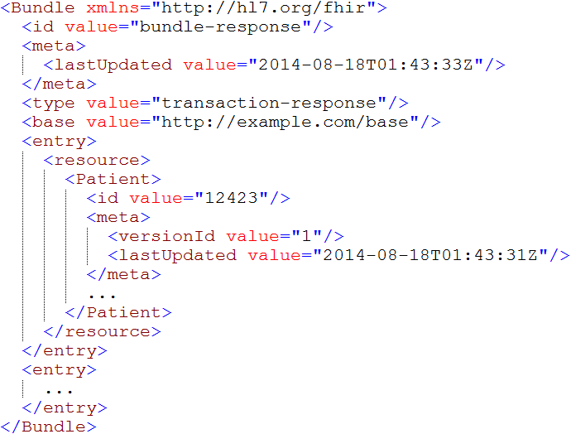
Bundles
Notes:
Note that the id of the resource is kept outside the resource itself
Atom has many other meta-data items (not shown), which we will discuss later.

Slide 28
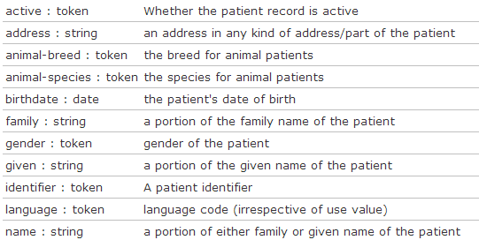
Search (patient)
Each resource has a set of “standard” search operations, so not every element can be searched!:

Slide 29
Combining parameters
Specifying multiple parameters finds resources matching all params ➔ “AND”
Parameters may list multiple values ➔ “OR”
Try:
https://server.org/fhir/Patient/_search?birthdate=1972-11-30&language=nl,fr

Slide 30

Education opportunities
Attend a Working Group Meeting
Tutorials, Connectathons
May 8-14 Paris
October 2-9 Atlanta
Attend an Implementation Workshop
Intensive tutorials, hands-on
This week
July 13-15 DC
November 16-18 Dallas
FHIR Institute Webinars
April 20-24 (Covers Day 1 from this implementation workshop)

Slide 31
QUESTIONS?
lmckenzie@gevityinc.com
Notes:
Don’t forget your evaluations!

